Slide 1
A DYNAMICSCON PRESENTATION
LIVE.DYNAMICSCON.COM

Slide 2
SQL TIPS AND TRICKS
by John Arnold
Rev 2.0

Slide 3
John Arnold
John_P_Arnold@hotmail.com
Rnoldz.com
Senior Software Engineer at US Digital in Vancouver, WA (Not Canada)
GP Administrator (day to day operations) since 2011
GP Customizations (C#, SQL, Modifier, VBA, SSRS….)
Dedicated family man who loves his family, woodworking, Lego, puzzles, and Mtn Dew
Born and raised in Pittsburgh but now calls the PNW home

Slide 4
SQL SERVER MANAGEMENT STUDIO (SSMS)
Object
Explorer
Formatting
Queries
Finding
Objects
Scripting
Objects
Tips
Shortcuts

Slide 5
SQL SERVER MANAGEMENT STUDIO (SSMS)
Object
Explorer
Formatting
Queries
Finding
Objects
Scripting
Objects
Tips
Shortcuts

Slide 6
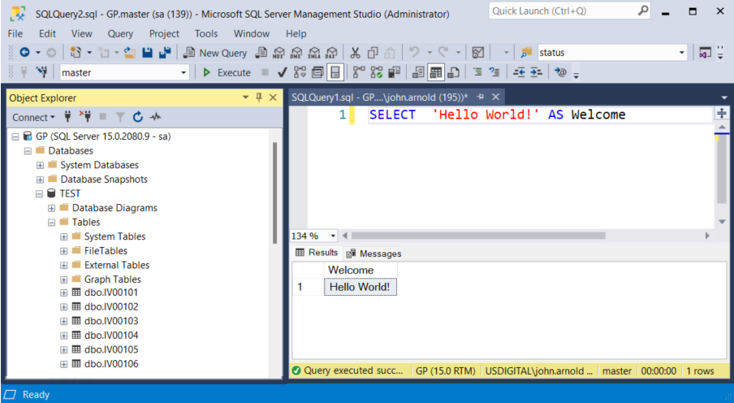
SSMS QUICK OVERVIEW
Query Window
Object
Explorer
Database Server & User
Note: GP is a DNS Alias
Results/Output
Window

Slide 7
RUNNING QUERIES
Shortcut keys
F5 – Run the highlighted text
Ctrl + R – Hide/Show results
Ctrl + D – Output to Grid
Ctrl + T – Output to Text
Ctrl + F – Output to File
Output to Text – easily find text in the results
Queries that update or delete data
DELETE DaTable
WHERE DaColumn = 'Da Value’
Play it safe
SELECT *
-- DELETE
FROM DaTable
WHERE DaColumn = 'Da Value’
Verify that the SELECT returns the correct data. Then highlight and execute from the DELETE to the end.

Slide 8
SSMS OPTIONS
Tools -> Options
Use the search box to easily find options in the tree.
Text Editor -> All Languages “Line Numbers” -> Check
SQL Server Object Explorer -> Commands -> Drag/Drop
Prepend dragged object name with schema and period -> False
Surround object name with brackets when dragged -> False

Slide 9
POORLY FORMATTED QUERY
Problems:
Inconsistent Indenting
Table Aliasing when not needed
Three tables are aliased as A
Two tables are aliased as B
It’s just hard to read

Slide 10
MY RULES FOR QUERIES
Prefix ALL column names with their table name
Do NOT alias table names unless you are joining to the same table more than once
No spaces in object names [ Brackets REALLY bug me ]
INNER and OUTER keywords are OPTIONAL
Do not hard code server or database names

Slide 11
MY RULES FOR FORMATTING QUERIES
CAPITALIZE capitalize all reserved words.
Left align all action keywords (SELECT, FROM, WHERE…)
Indent and align all columns and table names
Do not use SELECT * (except for IF EXISTS)
Spend the time to make the query readable. Make it readable for the future you

Slide 12
ArnoldIfication OF QUERIES
ALTER PROCEDURE _usd_CutfileSelect
@ManufactureOrder CHAR(31)
AS
SELECT RTRIM(IV00101Finished.ITEMNMBR) AS IV00101FinishedItem,
RTRIM(IV00101Finished.ITEMDESC) AS ItemDescription,
RTRIM(IV00101Component.ITEMNMBR) AS CutFileItem,
CONVERT(INT, WO010032.ENDQTY_I) AS Quantity
FROM WO010032
JOIN PK010033
ON PK010033.MANUFACTUREORDER_I = WO010032.MANUFACTUREORDER_I
JOIN IV00101 AS IV00101Finished
ON IV00101Finished.ITEMNMBR = WO010032.ITEMNMBR
LEFT JOIN IV00101 AS IV00101Component
ON PK010033.ITEMNMBR = IV00101Component.ITEMNMBR
WHERE WO010032.MANUFACTUREORDER_I = @ManufactureOrder
AND IV00101Component.ITMCLSCD = 'CUTFILE'

Slide 13
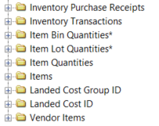
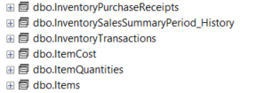
GP SMARTLISTS AND SQL VIEWS
GP comes with over 2,000 tables and 500 views
Examine views to learn how GP tables should be joined
Most SmartLists in GP get their data from a SQL View
SmartLists SQL Views

Slide 14
EXAMINING GP SQL VIEWS
Find the view in Object Explorer
Right click on the view and select “Script View As” -> CREATE To -> New Query Editor Window
DO NOT select Design – it will mess any formatting you have applied to your query
Reformat the GP supplied query to make it more readable

Slide 15
SCRIPT InventoryPurchaseReceipts
Scripted as one long line over 2,200 characters long…
Remove the database schema (.dbo) and more
Tools -> Options -> SQL Server Object Explorer -> Scripting
Delimit individual statements -> False
Include descriptive headers -> False
Script USE <database> -> False
Schema qualify object names -> False

Slide 16
InventoryPurchaseReceipts
Scripted again with the options turned off
Reformat the query
Manually reformat the query
Use poorsql.com website
Use Poor Man’s SQL Formatter SSMS / Visual Studio plugin.
Press Ctrl + K, F to format INSIDE OF SSMS!!!

Slide 17
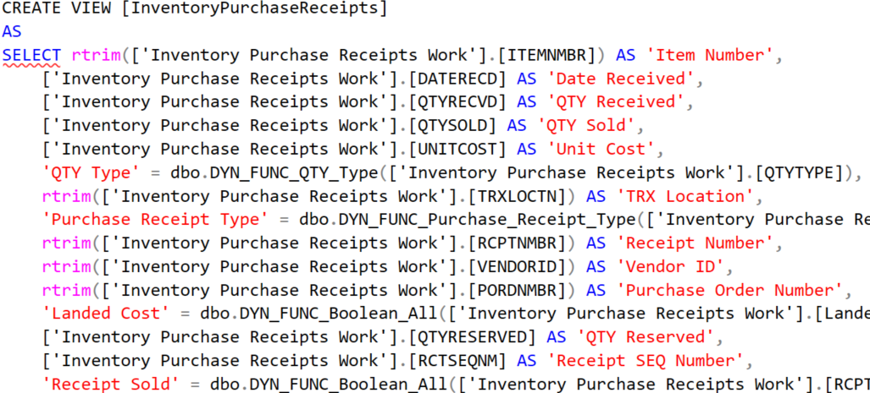
SCRIPT InventoryPurchaseReceipts
Poorsql - it may not be perfect, but it is much more readable

Slide 18
REFORMAT QUERY – SHORTCUT KEYS
Keep your fingers on the keyboard and off the mouse
https://learn.microsoft.com/en-us/sql/ssms/sql-server-management-studio-keyboard-shortcuts
Alt + Shift + Enter – Toggle full screen
Ctrl + R – Hide/Show results sets
Arrow Keys – Moves cursor around
Ctrl + Left/Right –Move cursor a word at a time
Ctrl + Up/Down – Scroll window
Home End – Beginning of this line’s text. 2nd, beginning of line
End Key – End of text on this line
Ctrl + Home/End – Beginning/End of file
Shift Key – Highlight text as you move the cursor
Works across most windows apps
Alt + Shift Key – Rectangle Mode Selection
Great way for editing blocks of text.
Ctrl + K, Ctrl + K – Set/Clear bookmark on current line
Ctrl + K, Ctrl + P/N – Go to the Previous/Next bookmark
Alt + Up/Down – Move current line (or selection) up/down
Ctrl + Shift + U – Uppercase selection
Ctrl + Shift + L – Lowercase selection
Tab – Indent selection
Shift + Tab – Unindent selection
Ctrl + K, C – Comment section
Ctrl + K, U – Uncomment section
Ctrl + F – Find
Ctrl + R – Find & Replace
F3 – Find again, forward
Shift + F3 – Find again, reverse
Ctrl + F3 – Find (forward) the word under the cursor
Ctrl + Shift + F3 – Find (reverse) the word under the cursor
The word does NOT have to be highlighted

Slide 19
REFORMAT QUERY – ARNOLDIFICATION
CREATE VIEW InventoryPurchaseReceipts
AS
SELECT RTRIM(IV10200.ITEMNMBR) AS ITEMNMBR,
IV10200.DATERECD,
IV10200.QTYRECVD,
IV10200.QTYSOLD,
IV10200.UNITCOST,
dbo.DYN_FUNC_QTY_Type(IV10200.QTYTYPE) AS QtyType,
RTRIM(IV10200.TRXLOCTN) AS TRXLOCTN,
dbo.DYN_FUNC_Purchase_Receipt_Type(IV10200.PCHSRCTY) AS PurchaseReceiptType,
RTRIM(IV10200.RCPTNMBR) AS RCPTNMBR,
RTRIM(IV10200.VENDORID) AS VENDORID,
RTRIM(IV10200.PORDNMBR) AS PORDNMBR,
dbo.DYN_FUNC_Boolean_All(IV10200.Landed_Cost) AS LandedCost,
IV10200.QTYRESERVED,
IV10200.RCTSEQNM,
dbo.DYN_FUNC_Boolean_All(IV10200.RCPTSOLD) AS ReceiptSold,
RTRIM(IV00101.ITMGEDSC) AS ITMGEDSC,
RTRIM(IV00101.ITEMDESC) AS ITEMDESC,
RTRIM(IV00101.USCATVLS_1) AS USCATVLS_1,
RTRIM(IV00101.USCATVLS_2) AS USCATVLS_2,
RTRIM(IV00101.USCATVLS_3) AS USCATVLS_3,
RTRIM(IV00101.USCATVLS_4) AS USCATVLS_4,
RTRIM(IV00101.USCATVLS_5) AS USCATVLS_5,
RTRIM(IV00101.USCATVLS_6) AS USCATVLS_6,
'dgpp://DGPB/?Db=&Srv=VW1PGP02&Cmp=USDGP&Prod=0' + dbo.dgppItemID(1, IV10200.ITEMNMBR, '') AS ItemNumberDrillBack,
'dgpp://DGPB/?Db=&Srv=VW1PGP02&Cmp=USDGP&Prod=0' + dbo.dgppVendorID(1, IV10200.VENDORID) AS VendorIdForDrillback
FROM IV10200
LEFT JOIN IV00101
ON IV10200.ITEMNMBR = IV00101.ITEMNMBR

Slide 20
ARNOLDIFICATION – WHY BOTHER?
The GP View has everything that is needed. Why not just it as is?
EVERYTHING is accessed by SQL even if it isn’t used
Extra tables and columns may be referenced
Modified AccountTransactions view at a GP site
Smartlist export to Excel took over two hours to run – SmartList->Excel is slow
The view referred to over 26 tables and many columns, most weren’t needed
The modified view joined to several other views
A new query was created that only returned what was needed.
The new query ran over 650 times faster. The Excel refreshable version took just 11 seconds to run.

Slide 21
OBJECT EXPLORER
The Object Explorer displays Tables, Views, Stored Procedures in the database(s) you are connected to.
Use left and right arrow keys to traverse the tree
Left arrow to go up the levels of the tree
Right arrow to open tree items
Type in name of object to easily find it in the list
Type “dbo.ObjectName”
In the Columns section under a table:
Drag one column name to the query window
Drag “Columns” tree header to bring all the columns to the query window – Great when writing INSERT statements

Slide 22
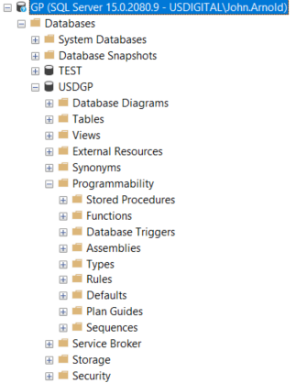
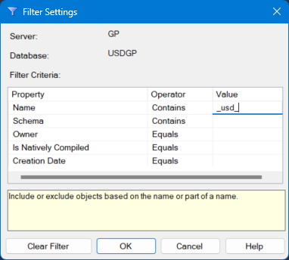
OBJECT EXPLORER
Filter Object Explorer
Right click on Tables, Views, Stored Procedures… and select Filter Settings
Enter value in Name field to filter by
Only the objects that match the filter will be show in the Object Explorer’s tree
Note: I prefix my objects with _usd_:
Easy way to filter to only see my objects
The leading _ makes them appear at the top
I can easily tell my objects from GP’s
Note: usd stands for US Digital, not US Dollars

Slide 23
QUERY THE SYSTEM – sys.objects
Special Table
sys.objects
Special Views
sys.tables
sys.columns
sys.procedures
Find all Inventory tables
SELECT sys.tables.name
FROM sys.tables
WHERE sys.tables.name LIKE 'IV%'
Find all table and column names for every column with the word “make” in its name.
SELECT sys.tables.name AS TableName,
sys.columns.name AS ColumnName
FROM sys.columns
JOIN sys.tables
ON sys.tables.object_id = sys.columns.object_id
WHERE sys.columns.name LIKE '%make%'

Slide 24
QUERY THE SYSTEM – sp_help [text]
sp_help Table/View
Display all column info (name, data type, length, precision, nullable…), Index, Constraints, Foreign Keys
Shortcut - Highlight name and press Alt + F1
Output to Text results to search for column names
sp_helptext SP/View
Display the SQL code for the Stored Procedure or View Specified.
Can be much faster than finding the Stored Procedure or View in Object Explorer
You can even look at system procedures

Slide 25
who - A MODIFIED VERSION OF sp_who
Needed to know who was logged into the TEST GP company before it could be restored from live
sp_helptext sp_who
Modified the parameters to accept a database name
ALTER PROCEDURE [who]
@dbName AS VARCHAR(128) = NULL,
@loginName AS VARCHAR(128) = NULL
AS
DECLARE @dbID AS INT
IF @dbName IS NOT NULL
BEGIN
SET @dbID = DB_ID(@dbName)
END
SELECT spid,
status,
RTRIM(loginame) as loginName,
hostname,
CASE
WHEN dbid <> 0
THEN DB_NAME(dbid)
ELSE ''
END AS dbname,
program_name,
cmd
FROM sys.sysprocesses
WHERE spid BETWEEN 0 AND 32767
AND ((@dbID IS NULL) OR (dbid = @dbID))
AND ((@loginName IS NULL)
OR (loginame LIKE @loginName))
ORDER BY 5,
loginame

Slide 26
“NEW” FUNCTIONS (15 YEARS OLD)
CASE vs IIF
CASE
WHEN dbid <> 0
THEN db_name(dbid)
ELSE ''
END AS dbname
IIF(Condition, value when true, value when false)
IIF (dbid=0,'',db_name(dbid)) AS dbname
TIP – Test for the positive
CASE vs CHOOSE
CASE SOP10100.SOPTYPE
WHEN 1 THEN 'Quote'
WHEN 2 THEN 'Order'
WHEN 3 THEN 'Invoice'
ELSE 'Unknown'
END AS OrderType
CHOOSE(Test Value, Value1, Value2, Value3…)
ISNULL(CHOOSE (SOP10100.SOPTYPE,
'Quote',
'Order',
'Invoice'),
'Unknown') AS OrderType

Slide 27
DRILL BACKS IN GP
The server and database names are hard coded in drill backs in GP
'dgpp://DGPB/?Db=&Srv=GPServerName&Cmp=GPDatabaseName&Prod=0’ + dbo.dgppItemID(1, IV10200.ITEMNMBR, '') AS ItemNumberDrillBack
Use @@SERVERNAME and DB_NAME() instead
'dgpp://DGPB/?Db=&Srv=' + @@SERVERNAME + '&Cmp=' + DB_NAME() + '&Prod=0' + dbo.dgppItemID(1, IV10200.ITEMNMBR, '') AS ItemNumberDrillBack

Slide 28
BULK INSERT WITH SSMS
Right Click Table -> Edit Top 200 Rows
Select SQL icon from toolbar to display the query
SELECT TOP (200) DaTableID, DaColumn
FROM Table_1
Edit the column order in the query to match the source data
Press Ctrl + R to refresh the output (F5 doesn’t work here)
Copy source data to the clipboard
Click on the row header to highlight the last/“blank” row
Paste to insert the rows of data

Slide 29
DATES & TIMES
DATETIME data type
Stored as a floating-point number
DDDD.HHHH
D – Number of days since 1/1/1900
5/23/2023 = 45067
H – fractional part of a day
6am = 0.25, 6pm = 0.5
Watch for rounding error
CAST(CAST('5/23/2023 2:25 PM' AS DATETIME) AS FLOAT)
45067.6006944444
CAST(45067.6006944444 AS DATETIME)
2023-05-23 14:24:59.997

Slide 30
DATES & TIMES – GP & Excel
DYNAMICS..ACTIVITY Table
LOGINDAT & LOGINTIM
SELECT LOGINDAT+LOGINTIM
FROM DYNAMICS..ACTIVITY
SQL 0 = 1/1/1900
Excel 0 = 1/0/1900
Excel 1 = 1/1/1900
SQL & Excel handle this difference & play nicely together
1/1/1900 in GP is a NULL date
SQL 1/1/1753 – 12/31/9999 Range

Slide 31
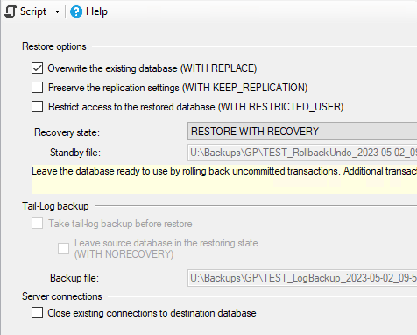
SCRIPTING WITH SSMS – TASKS
Backup / Restore
Tasks -> Restore -> Database
Script -> New Query Editor Window
USE [master]
RESTORE DATABASE [TEST]
FROM DISK = N'U:\...\FileToRestore.bak'
WITH FILE = 1,
NOUNLOAD,
REPLACE,
STATS = 5

Slide 32
SCRIPTING WITH SSMS – NEW TABLES
New Table
Tables -> Right Click -> New Table
Right Click -> Generate Change Script
BEGIN TRANSACTION
GO
CREATE TABLE dbo.Table_1
(
DaTableID int NOT NULL IDENTITY (1, 1),
DaColumn varchar(50) NOT NULL
) ON [PRIMARY]
GO
ALTER TABLE dbo.Table_1 ADD CONSTRAINT
PK_Table_1 PRIMARY KEY CLUSTERED
(
DaTableID
) WITH( STATISTICS_NORECOMPUTE = OFF, IGNORE_DUP_KEY = OFF, ALLOW_ROW_LOCKS = ON, ALLOW_PAGE_LOCKS = ON) ON [PRIMARY]
GO
ALTER TABLE dbo.Table_1 SET (LOCK_ESCALATION = TABLE)
GO
COMMIT

Slide 33
TABLE DESIGN MODIFICATIONS
Ever make a change to a table and try to save it, but it fails? (DaColumn -> VARCHAR(100)
Tools -> Options -> Designers -> Prevent saving changes that require table re-creation -> Un-Check
(Warning – be careful!)
Right Click -> Generate Change Script
BEGIN TRANSACTION
GO
CREATE TABLE dbo.Tmp_Table_1
(
DaTableID int NOT NULL IDENTITY (1, 1),
DaColumn varchar(100) NOT NULL
) ON [PRIMARY]
GO
ALTER TABLE dbo.Tmp_Table_1 SET (LOCK_ESCALATION = TABLE)
GO
SET IDENTITY_INSERT dbo.Tmp_Table_1 ON
GO
IF EXISTS(SELECT * FROM dbo.Table_1)
EXEC('INSERT INTO dbo.Tmp_Table_1 (DaTableID, DaColumn)
SELECT DaTableID, DaColumn FROM dbo.Table_1 WITH (HOLDLOCK TABLOCKX)')
GO
SET IDENTITY_INSERT dbo.Tmp_Table_1 OFF
GO
DROP TABLE dbo.Table_1
GO
EXECUTE sp_rename N'dbo.Tmp_Table_1', N'Table_1', 'OBJECT'
GO
ALTER TABLE dbo.Table_1 ADD CONSTRAINT
PK_Table_1 PRIMARY KEY CLUSTERED
(
DaTableID
) WITH( STATISTICS_NORECOMPUTE = OFF, IGNORE_DUP_KEY = OFF, ALLOW_ROW_LOCKS = ON, ALLOW_PAGE_LOCKS = ON) ON [PRIMARY]
GO
COMMIT

Slide 34
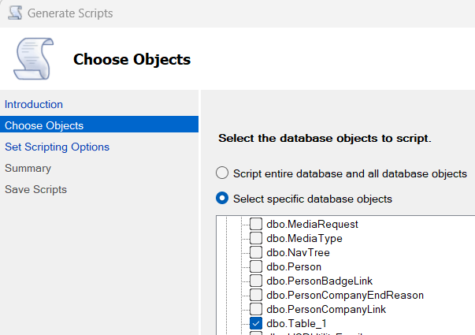
SCRIPTING WITH SSMS – BULK
Generate Scripts for many objects at once.
Right Click on Database -> Tasks -> Generate Scripts
Choose what to script
Specify where to save it
Generate one file or many
Only script one table in this example

Slide 35
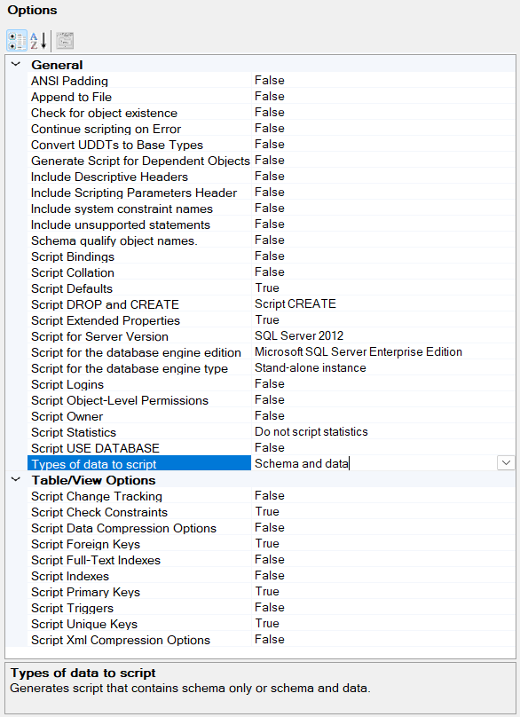
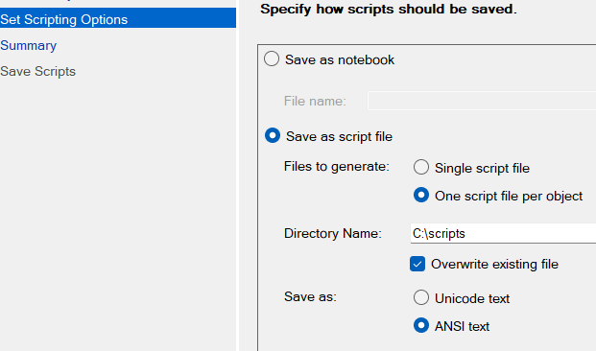
SCRIPTING WITH SSMS – BULK
Script one ANSI file per object
Advanced Options
Types of data to script -> Schema and data
Note: This scripting can take a long time to run

Slide 36
SCRIPTING WITH SSMS – BULK
Next -> Next to generate script(s)
SET ANSI_NULLS ON
SET QUOTED_IDENTIFIER ON
CREATE TABLE [Table_1](
[DaTableID] [int] IDENTITY(1,1) NOT NULL,
[DaColumn] [varchar](50) NOT NULL,
CONSTRAINT [PK_Table_1] PRIMARY KEY CLUSTERED
(
[DaTableID] ASC
)WITH (PAD_INDEX = OFF, STATISTICS_NORECOMPUTE = OFF, IGNORE_DUP_KEY = OFF, ALLOW_ROW_LOCKS = ON, ALLOW_PAGE_LOCKS = ON) ON [PRIMARY]
) ON [PRIMARY]
SET IDENTITY_INSERT [Table_1] ON
INSERT [Table_1] ([DaTableID], [DaColumn]) VALUES (1, N'a')
INSERT [Table_1] ([DaTableID], [DaColumn]) VALUES (2, N'b')
INSERT [Table_1] ([DaTableID], [DaColumn]) VALUES (3, N'c')
INSERT [Table_1] ([DaTableID], [DaColumn]) VALUES (4, N'd')
INSERT [Table_1] ([DaTableID], [DaColumn]) VALUES (5, N'e')
INSERT [Table_1] ([DaTableID], [DaColumn]) VALUES (6, N'f')
INSERT [Table_1] ([DaTableID], [DaColumn]) VALUES (7, N'g')
SET IDENTITY_INSERT [Table_1] OFF

Slide 37
SCRIPTING WITH SSMS – BULK
Why Script?
Script Data Only – searching for data
Script Table Structure – Save to Source Code Control to track changes
Stored Procedures/Views – Save to Source Code. Search for where things are used.
Migrate changes from a Test database to the Live system

Slide 38
SQL TIPS AND TRICKS
Questions or Comments?
John Arnold
John_P_Arnold@hotmail.com
Rnoldz.com

